Slide 1
Video Analytics using Machine Learning
Professor Feng Mai and PhD student Shanshan Yang
Group Members: ShuYu Hsu, Ravikiran Sriram, Isabella Valentino
By Isabella Valentino

Slide 2
Project Overview:
This research project aims to explore the application of machine learning techniques in video analysis. The primary goal is to extract meaningful information from video data, focusing on text, key frame, and audio analysis. By analyzing CEO interviews and applying various machine learning algorithms, our team seeks to determine how these algorithms can be used to gain insights from video content, especially in terms of company discussions and executive sentiment.
Team Collaboration:
Data Validation: Our team tackled a large dataset consisting of over 10,000 rows of video metadata. The dataset was split evenly among team members, each responsible for validating specific sections.
Task Specialization: After data validation, the team divided tasks according to expertise:
Text Analysis: ShuYu
Key Frames Analysis: Ravikiran
Audio Analysis: Isabella (myself)
This presentation will specifically address the audio analysis aspect of this project. I focus on extracting and analyzing audio features from CEO interviews to detect emotions and their potential impact on stock prices. By employing machine learning models, I train a Convolutional Neural Network (CNN) to classify various emotions based on audio data. I then compare the detected emotions with stock prices at the video upload date and 24 hours later to investigate any correlations between CEO sentiment and market movements. This approach integrates audio analysis with financial data to explore how emotional tone in leadership communication might influence investor behavior.

Slide 3
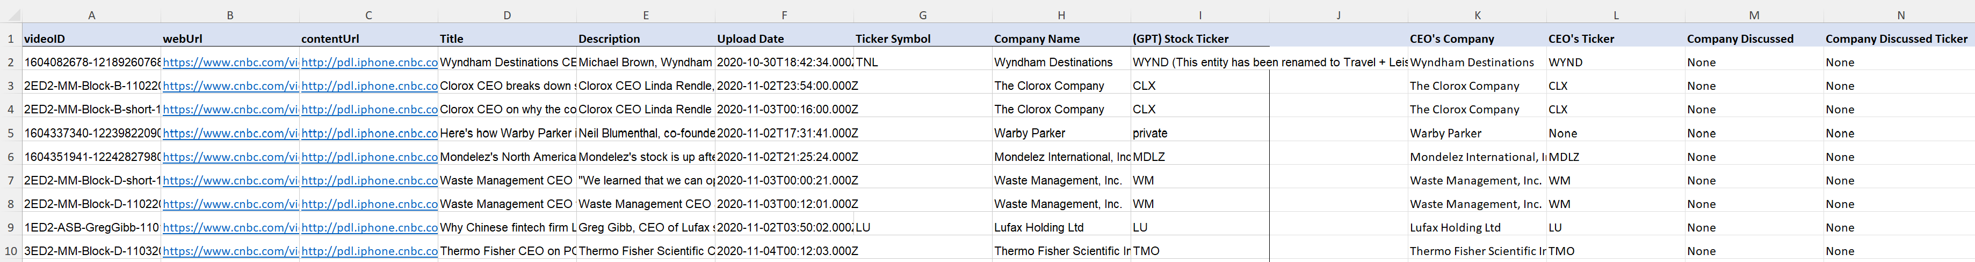
Metadata Validation Process:
Objective: To validate and categorize company names and stock tickers mentioned in video metadata for further analysis.
File Overview: Each row represents a video, including the videoID, webUrl, contentUrl, Title, Description Upload Date, Ticker Symbol, and Company Name.
Validation:
Checked if executives from companies are featured in the video.
Created columns to distinguish between the CEO's own company and the company discussed in the video.
Used Yahoo Finance, Google, and Macrotrends to confirm CEO’s, company names, and tickers.
Visuals:

Slide 4
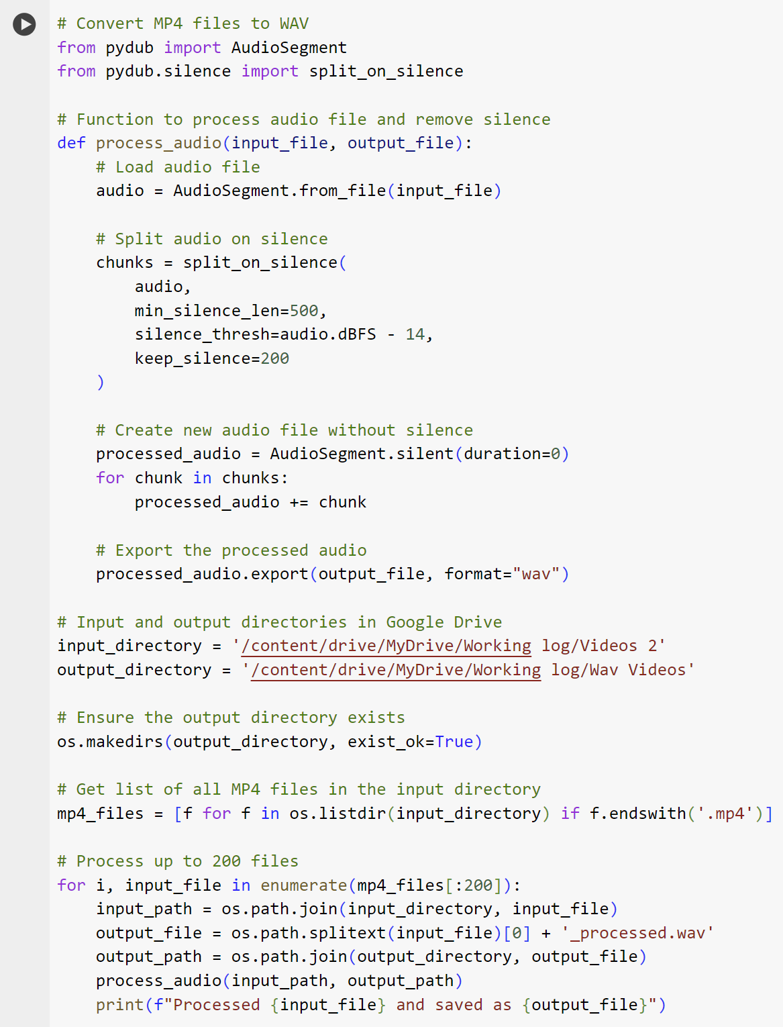
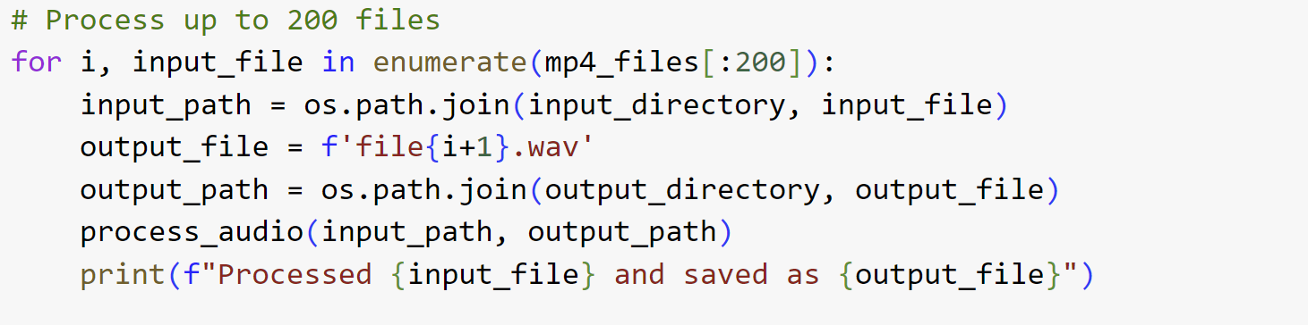
Audio Format Conversion:
Process: Converted 200 MP4 videos to WAV format using the provided Python code to handle audio data efficiently.
Code Explanation:
Library Used: pydub for audio processing.
Function: Process audio by removing silence and exporting cleaned WAV files.

Slide 5
Audio Features for Emotion Classification:
Zero Crossing Rate (ZCR):
Measures the rate at which the signal changes sign, useful for identifying noisiness.
Chroma Features:
Represent the 12 different pitch classes, relevant for capturing harmonic content.
MFCC (Mel Frequency Cepstral Coefficients):
Capture the power spectrum of the audio signal, essential for speech recognition.
RMS (Root Mean Square):
Represents the energy of the audio signal, useful for understanding volume changes.
Mel Spectrogram:
Shows the spectrum of frequencies over time, providing a visual representation of the audio signal's frequency content.

Slide 6
Datasets for Emotion Classification:
TESS (Toronto Emotional Speech Set):
Contains audio recordings of two female actresses portraying seven emotions by speaking 200 target words.
Emotions: happy, pleasant surprise, fear, angry, disgust, sad, and neutral.
RAVDESS (Ryerson Audio-Visual Database of Emotional Speech and Song):
7,356 files with 24 actors (12 female, 12 male) expressing seven emotions in speech and five in song, at two levels of intensity.
Speech emotions: calm, happy, sad, angry, fearful, surprise, and disgust.
Song emotions: calm, happy, sad, angry, and fearful emotions.
CREMA-D (Crowd-sourced Emotional Multimodal Actors Dataset):
7,442 clips from 91 actors portraying six emotions across four levels of intensity.
Emotions: sad, angry, disgust, fear, happy, and neutral.
SAVEE (Surrey Audio-Visual Expressed Emotion):
480 utterances from 4 male actors expressing seven emotions, recorded in British English.
Emotions: happy, sad, angry, fearful, disgust, surprised, and neutral.

Slide 7
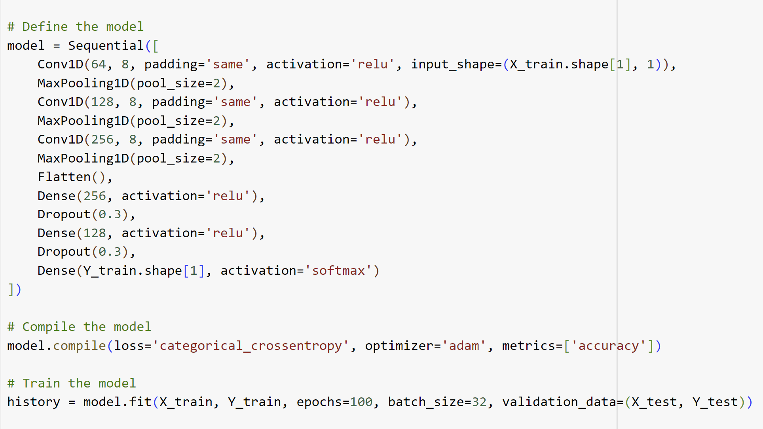
Model Training:
Architecture:
Conv1D Layers: Used to capture temporal features from the 1D audio data.
MaxPooling: Applied to reduce dimensionality and highlight essential features.
Dense Layers: Fully connected layers to make final predictions.
Dropout: Used to prevent overfitting by randomly dropping units during training.
Metrics:
Accuracy: Measured how well the model predicts the correct emotion.
Loss: Indicates how far the model's predictions are from the actual emotions.
Approach: Implemented a Convolutional Neural Network (CNN) to classify emotions based on extracted features.

Slide 8
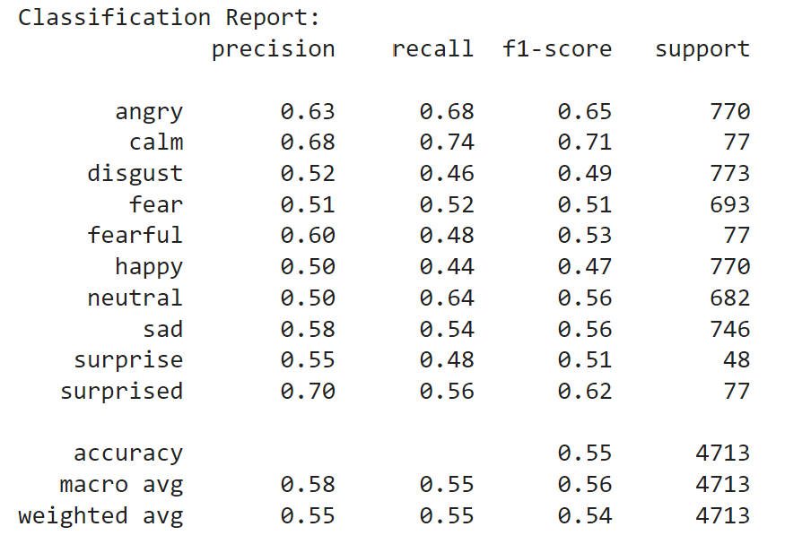
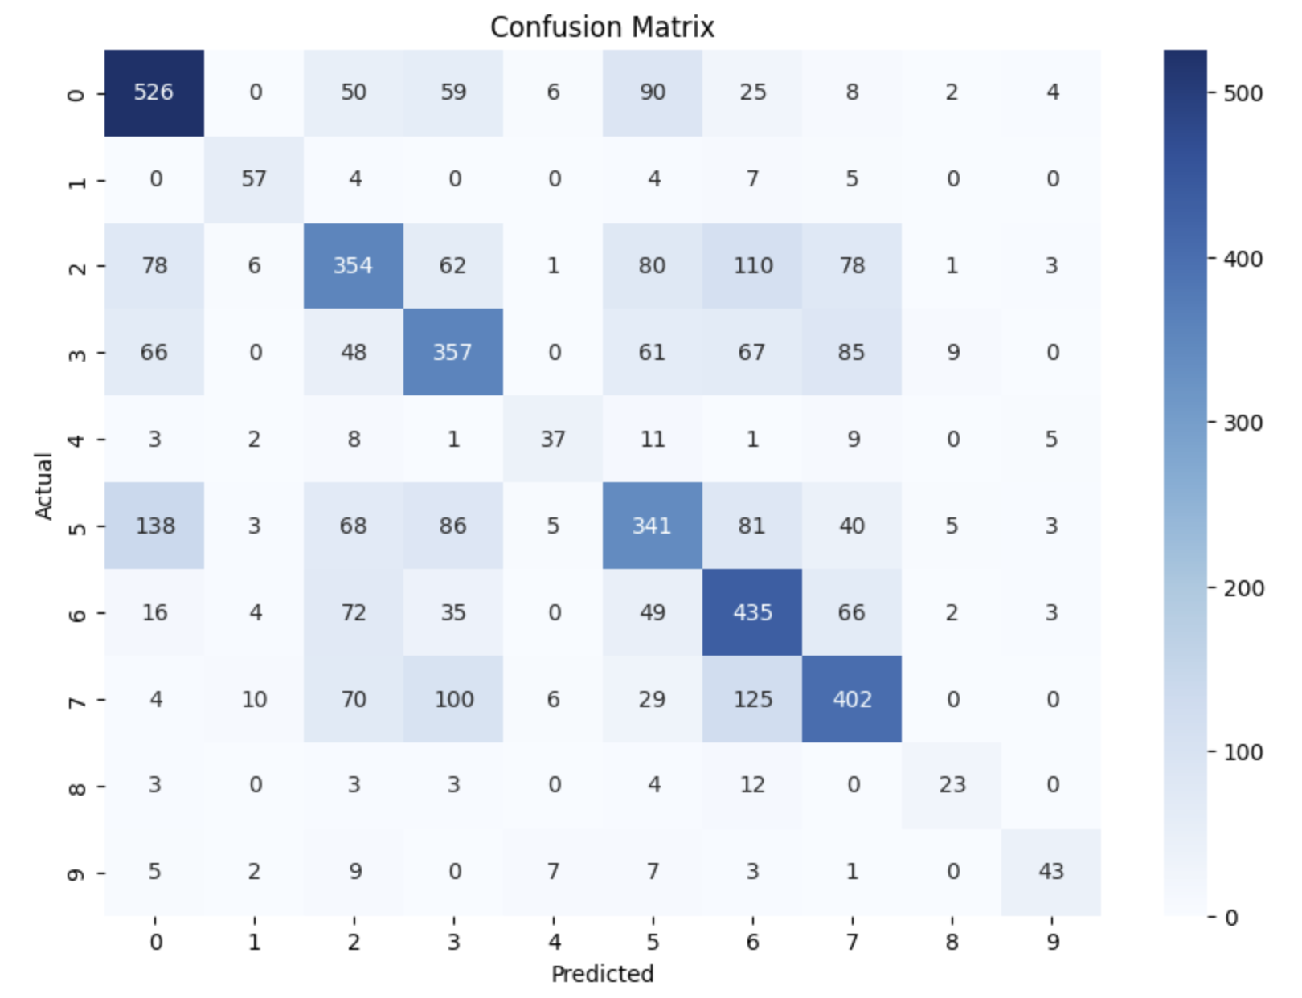
Results and Performance Analysis:
 | Training Results | Testing Results
Accuracy | 98.93% | 54.63%
Loss | 0.0397 | 4.9278
Overall Accuracy: The model has an accuracy of 55%, indicating moderate effectiveness in classifying emotions.
High Performance: Emotions like "calm" and "angry" are classified with higher precision and recall (68-74%), showing that the model is more reliable for these emotions.
Confusion Between Emotions: The confusion matrix reveals that "disgust" is often misclassified as "happy" or "neutral," and "fear" is frequently confused with "angry." This suggests difficulties in distinguishing between these emotions.
Inconsistent Performance: The F1-scores vary from 0.47 for "happy" to 0.71 for "calm," indicating the model is more accurate for some emotions than others.

Slide 9
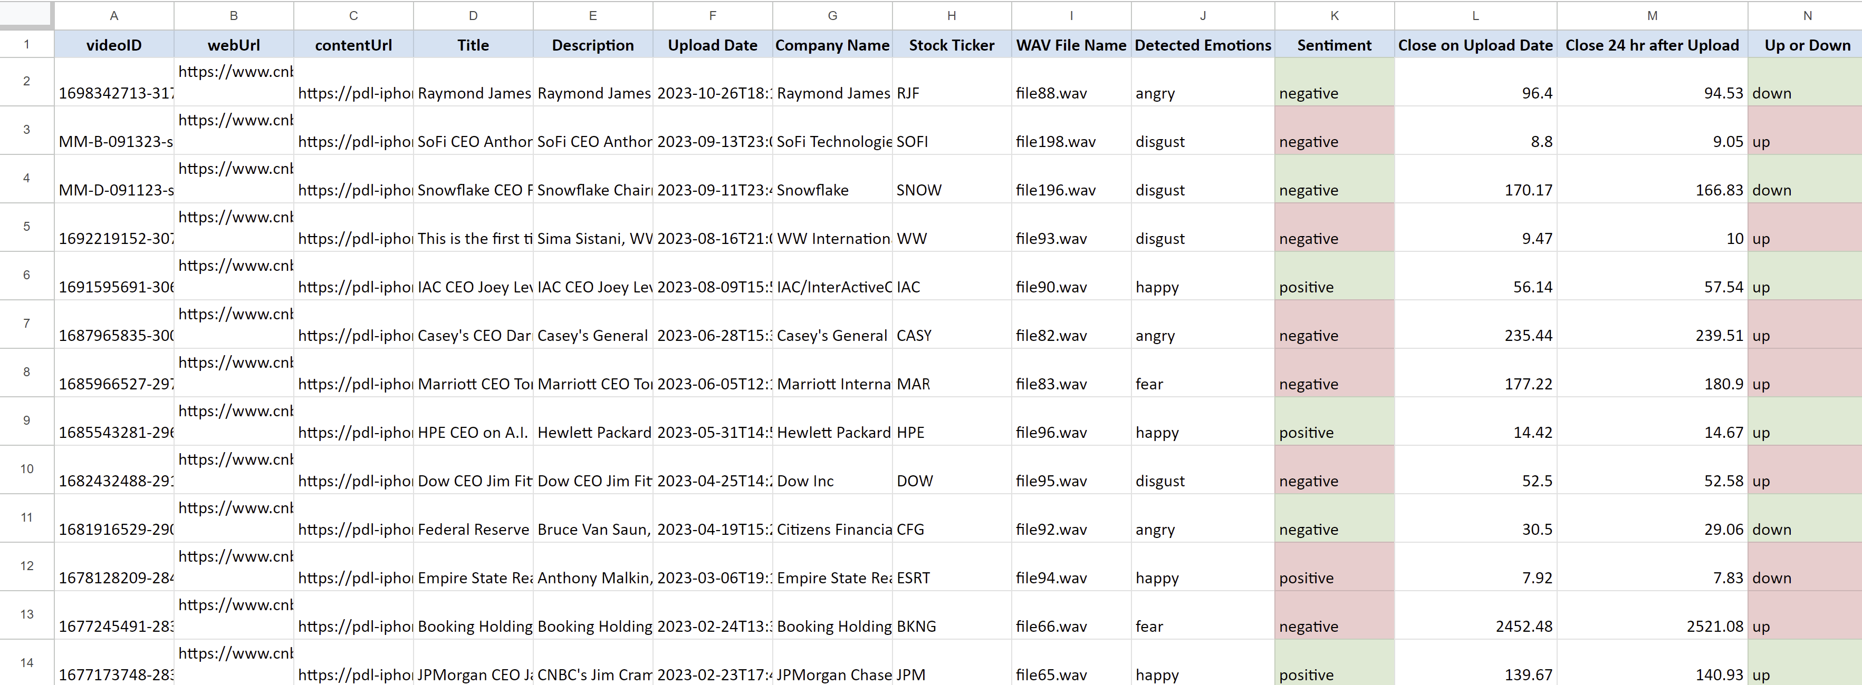
Analysis and Stock Price Comparison:
Sentiment Analysis: Used the model's output to determine sentiment for each audio file.
Positive: happy, calm, and pleasant surprise.
Negative: angry, disgust, fear, and sad.
Neutral: neither strongly positive nor negative.
Data Matching:
Cross-referenced WAV files with validated metadata.
Retrieved stock close prices for the upload date.
Compared stock prices at upload with those 24 hours later to assess price movement.
Correlation Analysis: Compared detected sentiment with stock price changes to identify potential correlations.
Conclusion: The initial analysis suggests a potential link between sentiment and stock price changes. Positive sentiment appears to be associated with an increase in stock prices in several cases, though there are exceptions. Negative sentiment shows mixed results, with both price increases and decreases observed. These preliminary findings indicate that sentiment might influence stock price movements, but further analysis with a larger dataset would be beneficial to draw more definitive conclusions.

Slide 10
Challenges and Future Directions:
Challenges:
Overfitting: The model displayed high accuracy during training but significantly lower accuracy on validation and test data, indicating overfitting.
Misclassification: The confusion matrix revealed that certain emotions, particularly "disgust" and "fear," were frequently misclassified, highlighting the difficulty in differentiating between similar emotions.
Dataset Imbalance: Variations in dataset size and emotion representation may have contributed to the model's performance inconsistencies.
Audio Quality: The test audio files provided contained not just the CEO's voice but also the interviewers' voices, which introduced noise. This likely contributed to the lower accuracy, as the model had to parse through irrelevant emotional cues from multiple speakers.
Future Work:
Dataset Expansion:
Consider incorporating additional datasets to increase the diversity and volume of training data, which could help the model generalize better.
Investigate data augmentation techniques to address class imbalance.
Improved Audio Data:
Use more accurate and isolated audio clips where only the CEO is speaking, which would likely enhance the model's ability to accurately detect emotions.
Advanced Models:
Explore more sophisticated architectures such as Transformer models or hybrid approaches combining CNNs with LSTMs to better capture temporal dependencies in the audio data.
Enhanced Sentiment Analysis:
Refine the sentiment-stock price correlation analysis by incorporating more financial metrics (e.g., trading volume, market sentiment) to better understand the impact of CEO emotions on stock performance.

Slide 11
Project Recap, Key Takeaways, and Q&A:
Project Recap:
Objective: Developed a model to classify emotions from CEO speech audio and analyzed the correlation between these emotions and subsequent stock price movements.
Approach: Utilized a CNN-based model for emotion classification, leveraging datasets like TESS, RAVDESS, CREMA-D, and SAVEE.
Results: Achieved moderate accuracy with challenges posed by diverse audio quality and dataset imbalances.
Key Takeaways:
Model Performance: The model demonstrated strong performance on training data but struggled with generalization due to overfitting and mixed audio inputs.
Emotion Detection: Accurate emotion detection is heavily dependent on clean, isolated audio data, underscoring the importance of high-quality datasets.
Impact Analysis: Preliminary sentiment-stock price analysis suggests a potential correlation, but further refinement with more robust data is needed.
Questions & Feedback: If you have any questions about the methodologies, results, or future directions of this project, please feel free to ask me. For further inquiries or more detailed discussions, you can reach me at ivalenti@stevens.edu. I would be happy to engage in deeper conversations and welcome any feedback you may have.
Thank you

